Slide 1


UBCO CAPSTONE PROJECT:
KELLY KLEE INSURANCE
PRESENTED BY VINAY NORI, AUSTIN LEE, JAE YOON CHO
JASMINE CHEN
KELLY KLEE INSURANCE

Slide 2


REPLACEMENT COST ESTIMATE
KELLY KLEE INSURANCE

Slide 3
TABLE OF CONTENTS
Kelly Klee Private Insurance (Introduction)
Motivation & Aims and Objectives
Methodology
RCE Modelling
Conclusions
02

Slide 4

“25 percent of Americans hold 74 percent of the country’s wealth, and this number is rising.”
- U.S. Census Bureau
Based in Aspen, CO, United Sates and is part of the Life Insurance Carriers Industry
The first and only online insurance brokerage for affluent Americans
Build comprehensive plans designed to cover all the important personal assets and wealth
Utilize an online platform to generate a package quote for the clients
03

Slide 5
MOTIVATION
The Replacement Cost Estimate (RCE): the value that the insurance company would have to cover, when the house is seriously damaged or destroyed.
The RCE has a HUGE impact on the premiums
Predicting this amount is crucial as it may cause the following problems:
Over Estimating causes poor customer experience
Eventually loses a potential lead
MOTIVATION,
AIMS
&
OBJECTIVES
KEY RESEARCH QUESTION
Can we create a model that provides the RCE cost of high-end homes?
OBJECTIVE
Create an automated model that allows to input various pieces of information and provides the RCE cost of high-end homes
04

Slide 6




Methodology
DATA PRE-PROCESSING
Google BigQuery and SQL to retrieve data.
Python to conduct statistical analysis to clean null values and duplicate records
DATA
ThirdParty Infutor
Contains all the information of home and personal information of customers
All the information is stored in the form of XML data
qqAssetIDs
Contains information about overview of asset information for sold customers
stored in the form of JSON
FEATURE ENGINEERING
Performing Log Transformation and removing outliers
Selecting best features using Information Gain and visualizations.
Regression
Supervised algorithms to achieve prediction models
Compare RMSE of different advanced regression models
MAE for interpretation
CONCLUSIONS
Analysis and selection of best prediction model results
05

Slide 7
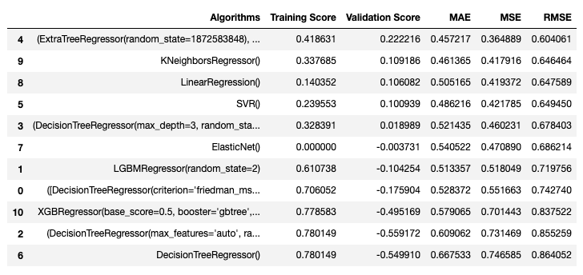
RCE Modelling:
Analysis Part 1.
Useful Features
RMSE Comparison Table
Building Square ft
Number of Bathrooms
Assed Value
Land Value
Fire Place
Market Value
Tier
05

Slide 8
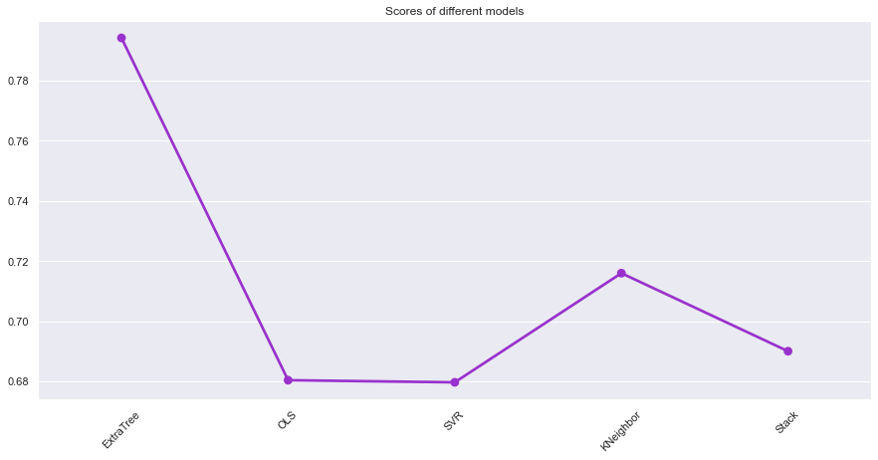
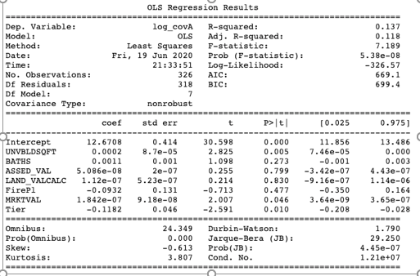
RCE Modelling:
Analysis Part 2.
RMSE Comparison Plot using Cross-validation
Ordinary Least Square Results
Compared Models:
Extra Trees, Ordinary Least Square, Support Vector, Kneighbors, Stack
05

Slide 9
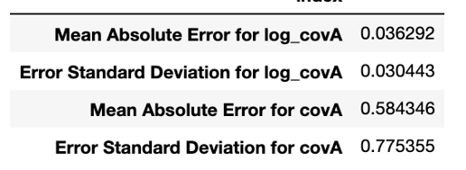
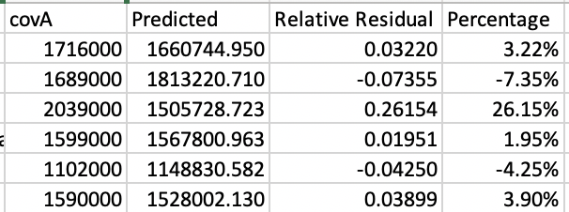
RCE Modelling:
Interpretation
MAE and Error Standard Deviation
Testing with new data points
68% confident interval: [0.0058489, 0.066735]
95% confident interval: [-0.024594, 0.097178]
95% confident that MAE is less than 10%
05

Slide 10
Log transformation and removing outliers: normalize target variable covA with more symmetrical distribution
Ordinary Least Square regression: the best suited model
95% confident: MAE is less than 10%
Affecting the model accuracy: lack of enough data points & missing values on important features
CONCLUSION
09

Slide 11
BEST CUSTOMER FIT MODEL(BCF)
KELLY KLEE INSURANCE
01

Slide 12
TABLE OF CONTENTS
Motivation
Aims and Objectives
BCF DATASETS
BCF ANALYSIS
BCF CLASSIFICATION
CONCLUSION
02

Slide 13
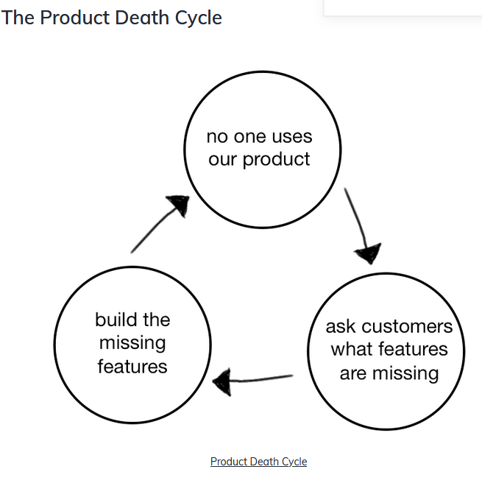
BACKGROUND & MOTIVATION
In the corporate management, companies seek to maximize the profits
The source of the profits depends largely on acquiring and retaining customers.
Using data mining skills helps analyze the features of both potential and current customers
Key Research Question
Identify the best fit customers (potential customers) based on technical fit, functional fit, Resource fit metrics
Identify the best filter conditions for bidding in ping-post system.
04

Slide 14


REQUIREMENTS
Identify the best filter condition to be applied on ping-post system
Build a classification model along with their posterior probabilities of conversion for classifying if Leads as potential customer or not.
SOFTWARE & TOOLS
DATABASE- Big Query, SQL
LANGUAGES- PYTHON,R
GOOGLE COLAB (with GPU: 2 CPUs, 13 GB RAM, 358 GB disk)
CLASSIFICATION - PYTHON SKLEARN, TENSORFLOW
03

Slide 15
DATA
DATA PRE-PROCESSING
Household - Contains all the information of sold customers. All the information is stored in the form of JSON data which contains vehicle, personal, health, household information of customers. The table has 46,009 records.
Lead-ping- Contains information about the leads that are to be classified. All the information is stored in the form of JSON data which contains vehicle, personal, health, household information of customers. The table has 37,306,856 records.
Python regex and statistical analysis to clean null values and duplicate records
FEATURE ENGINEERING
Selecting best features using Information Gain and visualizations.
CLASSIFICATION
Unsupervised and supervised algorithms to classify potential customers
CONCLUSIONS
Analysis and selection of best model results
05

Slide 16




DATA ANALYSIS PART-1
Challenges
Data pre-processing
Huge datasets around (38 million records) in an Unstructured Json format.
Pandas operations failed due to out of RAM and disk memory issues.
Most of the data records have nulls and unstructured syntax due to which the pre-built functions to load JSON data failed and pre-processing became very difficult.
Few Records for training data (440 records with 9 columns) and testing data has 37 million records due to which accessing accuracy and testing became difficult.
DATA EXTRACTION
DATA CLEANING
DATA SPLIT
DATA MERGE
Python regex is used to clean and extract data of improper format
Data column values with duplicates and more than 50% null are dropped
Data is split into separate files by the created date
Separate data files are merged together into a single data frame for analysis
Key Observations
Comparing leads with current customers:
Current customers are mainly from Colorado and Texas residents.
Leads are mainly from Texas and Georgia. The number of Co. leads is out of top 10
06

Slide 17
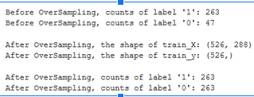
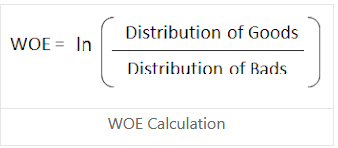
DATA ANALYSIS PART-2
FEATURE ENGINEERING
CLASS IMBALANCE
INFORMATION VALUE
OVER SAMPLING SMOTE ANALYSIS
Data is said to be imbalanced when instances of one class outnumber the other(s) by a large proportion.
Feeding imbalanced data to your classifier can make it biased in favour of the majority class, simply because it did not have enough data to learn about the minority.
Information value is a very useful concept for variable selection during model building.
Information Value (IV) is a measure of the predictive capability of a categorical x variable to accurately predict the goods and bads(response).
IV = ∑ (% of non-events - % of events) * WOE
Synthetic Minority Over-Sampling Technique abbreviated as SMOTE is the technique that generates synthetic data for the minority class.
07

Slide 18







CLASSIFICATION
MODELS WITH ACCURACY & ROC values
LOGISTIC REGRESSION
RANDOM FOREST
NAIVE BAYES
SUPPORT VECTOR MACHINE
NEURAL NETWORK
ACCURACY - 86%
ROC CURVE AREA- 0.81%
ACCURACY - 66%
ROC CURVE AREA- 0.64
ACCURACY - 87%
ROC CURVE AREA- 0.85
ACCURACY - 77%
ROC CURVE AREA- 0.74
ACCURACY - 79%
ROC CURVE AREA- 0.76
08

Slide 19

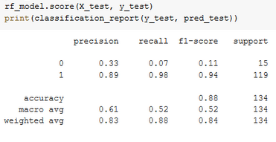
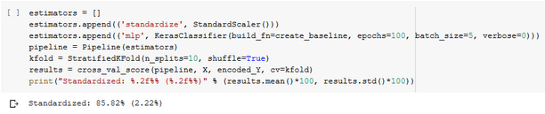
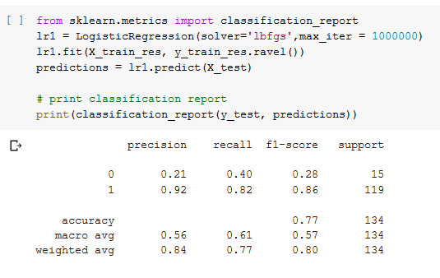
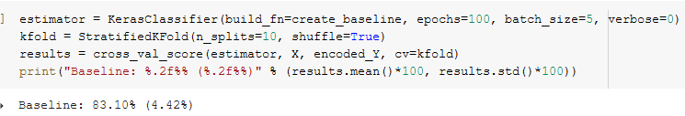
Random forest
Neural Network
Logistic Regression
09

Slide 20
conclusion
BEST FILTERS:-
The features with high Information Value are selected for further analysis and modelling the data. The following filters are classified as the best filter conditions for the ping-post system
"Model",”marital_status”,"garage_state","residence_use_type","make","year", "education_type","licensed_state","occupation","work_status","relationship",
"status"
BEST CLASSIFIER:-
BEST CLASSIFIER:-
Random Forest / Neural Network combination of 274 input layers with a standardized scalar gave the best performance of classification.
10

Slide 21
ACKNOWLEDGMENT
We wish to express our sincere gratitude to Mr. Kasey Luft, Data Engineer from Kelly Klee, who gave us valuable inputs and providing us opportunity to work for Kelly Klee Insurance.
Our sincere thanks to all the Professors and TA’s for their guidance and encouragement in carrying out this MDS program.
11

Slide 22
THANK YOU !!
ANY QUESTIONS?

